Slide 1
Web Servers and Server-side Scripting

Slide 2
Outline
Introduction
Web hosting
Types of hosting
Web deployment
Apache server configuration
Website securites
Introduction PHP
Scripting with PHP - Variables, Data Types, Functions, Forms

Slide 3
Web Server
A web server is server software, that can satisfy client HTTP requests on the public World Wide Web or also on private LANs and WANs.
The primary function of a web server is to store, process and deliver web pages to clients.
This primary function definition was good a few decades ago but nowadays it is better to use the terms of Web contents and / or Web resources instead of Web Pages because it cover all kind of contents that can be delivered to clients by web server.
Examples of Web contents may be HTML files, XHTML files, image files, style sheets, scripts, other types of generic files that may be downloaded by clients, etc…
A user agent, commonly a web browser or web crawler, initiates communication by making a request for a specific resource using HTTP and the server responds with the content of that resource or an error message if unable to do so.
Commonly used web servers,
  For PHP: Apache
  For ASP: IIS
  For JSP: Tomcat, Glassfish

Slide 4
Web hosting and Deployment
Web hosting refers to the service that provides individuals and organizations with the technology and infrastructure needed to make their websites accessible via the World Wide Web.
It involves storing website files, data, and content on servers connected to the internet, allowing users to access the website using a web browser.

Slide 5
Importance of Web Hosting
Online Presence
Reliability and Uptime
Performance and Speed
Scalability and Flexibility
Security and Data Protection
Technical Support and Maintenance

Slide 6
Types of Web Hosting
Shared hosting
Virtual Private Server (VPS)
Dedicated Hosting
Cloud Hosting

Slide 7
Shared Hosting
Definition: Shared hosting involves hosting multiple websites on a single server. Resources such as CPU, RAM, and disk space are shared among multiple users.
Pros:
  Cost-effective: Shared hosting plans are usually affordable, making them suitable for small websites and beginners.
  Easy to manage: Hosting provider takes care of server maintenance and management tasks.
Cons:
  Limited resources: Sharing resources with other websites can lead to performance issues during traffic spikes.
  Security risks: Vulnerabilities in one website can affect others on the same server.

Slide 8
Virtual Private Server (VPS)
Definition: VPS hosting provides dedicated resources within a virtualized environment. Each user has their own isolated virtual server instance.
Pros:
  Scalability: Users can scale resources (CPU, RAM, storage) according to their needs.
  Improved performance: Guaranteed resources ensure consistent performance even during peak traffic.
Cons:
  Higher cost: VPS hosting is more expensive than shared hosting but offers better performance and control.
  Technical expertise required: Users may need some technical knowledge to manage and configure their VPS.

Slide 9
Dedicated Hosting
Definition: Dedicated hosting provides an entire physical server exclusively for one user. The user has full control over server resources and configurations.
Pros:
  High performance: Dedicated resources ensure optimal performance and reliability for high-traffic websites and applications.
  Complete control: Users have full administrative access to customize server settings and install software.
Cons:
  Expensive: Dedicated hosting is the most expensive option due to exclusive use of server resources.
  Requires maintenance: Users are responsible for server maintenance, security, and updates.

Slide 10
Cloud Hosting
Definition: Cloud hosting utilizes a network of virtual servers to host websites and applications. Resources are dynamically allocated and distributed across multiple servers.
Pros:
  Scalability: Resources can be scaled up or down based on demand, allowing for flexibility and cost efficiency.
  High availability: Redundant infrastructure ensures minimal downtime and improved reliability.
Cons:
  Potential for resource contention: Shared resources in the cloud may lead to performance issues if not managed properly.
  Dependency on provider: Reliability and performance depend on the cloud service provider's infrastructure and services.

Slide 11
What is Web Deployment?
Web deployment refers to the process of making a website accessible on the internet by uploading website files and configuring server settings.
  Uploading Website Files to a Web Server
  Configuring Server Settings
  Testing and Verifying Website Functionality
  Making Website Live

Slide 12
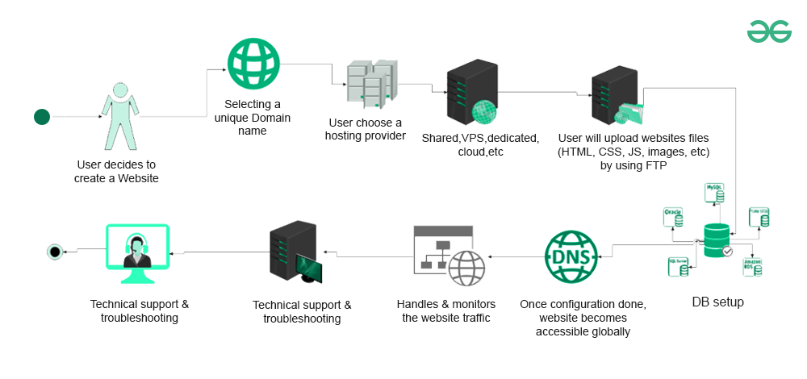
Uploading Website Files to a Web Server

Slide 13
Uploading Website Files to a Web Server
Step 1: Select a Web Hosting Provider: Choose a web hosting provider that meets your website's needs in terms of storage, bandwidth, and server capabilities.
Step 2: Access Server Space: Obtain access credentials (e.g., FTP username and password) to connect to the web server where your website will be hosted.
Step 3: Transfer Website Files: Use FTP (File Transfer Protocol) or a web-based file manager provided by the hosting provider to upload your website files (HTML, CSS, JavaScript, images, etc.) to the server.

Slide 14
Configuring Server Settings
Step 4: Domain Configuration: If you have a domain name, configure domain settings to point to the web server's IP address. This typically involves updating DNS (Domain Name System) records.
Step 5: Server Configuration: Configure server settings such as directory structure, file permissions, security measures, and server software (e.g., Apache, Nginx).
Step 6: Database Setup (if applicable): If your website requires a database (e.g., MySQL, PostgreSQL), set up the database and configure connection settings in your website's configuration files.

Slide 15
Testing and Verifying Website Functionality
Step 7: Testing Environment: Create a staging environment or use a testing server to test website functionality before making it live.
Step 8: Browser Testing: Test the website on different web browsers (e.g., Chrome, Firefox, Safari, Edge) and devices (desktop, mobile, tablet) to ensure compatibility and responsiveness.
Step 9: Functionality Testing: Verify that all website features, links, forms, and interactive elements are working correctly.

Slide 16
Making Website Live
Step 10: Final Checks: Double-check all configurations, settings, and files to ensure everything is in place and functioning as expected.
Step 11: Go Live: Once testing is complete and you are satisfied with the website's performance, make the website live by updating DNS records to point to the web server and removing any maintenance or "under construction" pages.
Step 12: Monitor and Maintain: Continuously monitor website performance, security, and functionality after deployment.
Implement regular backups, security updates, and performance optimizations to keep the website running smoothly.

Slide 17
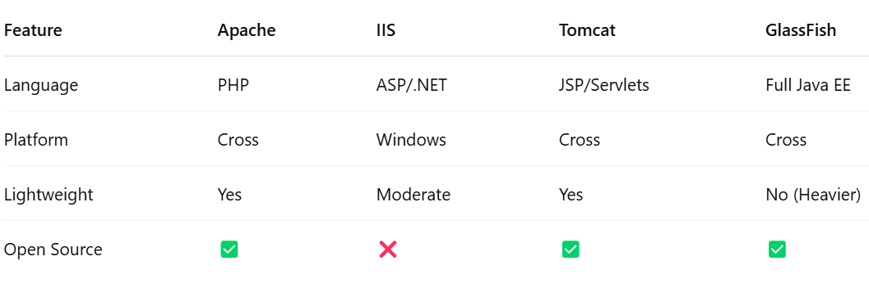
Web Servers

Slide 18
Apache web server
The Apache HTTP Server ("httpd") was launched in 1995 and it has been the most popular web server on the Internet since April 1996.
We can download and install apache web server separately from http://httpd.apache.org/download.cgi
We can also download Apache web server with bundle like XAMPP, WAMP or LAMP.
  XAMPP is the most popular PHP development environment consist of Apache, MariaDB, PHP, Perl and many other packages.
  WAMP is popular PHP development environment for Windows OS.
  LAMP is popular PHP development environment for Linux based OS.
We are going to use XAMPP bundle as it has installable versions of Windows as well as Linux.
We can download XAMPP and install XAMPP from https://www.apachefriends.org/index.html

Slide 19
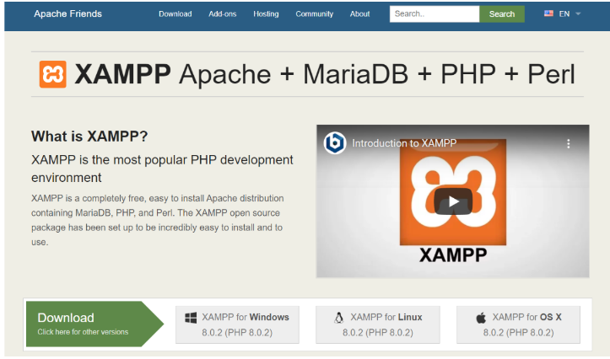
Installing XAMPP
Step 01: Download XAMPP installable from https://www.apachefriends.org/index.html

Slide 20
Installing XAMPP (Cont.)
Step 02: start the installation by double clicking on the downloaded package
*Note: you might get this warning before installation begins, which suggest that UAC policy may restrict XAMPP to perform some functions if we install it in C drive.
Press OK in this warning, as we are not going to install XAMPP on C drive.
After some screen you will get below screen, change the destination to other then C Drive.
After changing the destination of installation, just follow the default installation process.

Slide 21
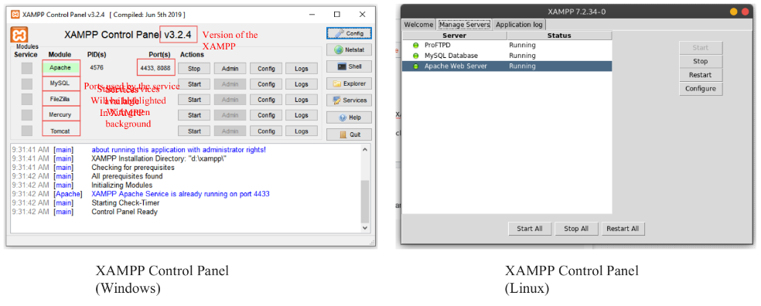
Installing XAMPP (Cont.)

Slide 22
Configuring Server (Apache)
Sometimes we need to change the server configuration in some specific conditions like,
  Port is occupied
  To add/load modules
  To change max upload size
  To change root directory
We can configure Apache server using httpd.conf file located at xampp/apache/conf folder.
We can configure some parameters of the server using php.ini file located at xampp/php folder.
Important settings in httpd.conf file are,
  Changing port number for apache : to change the port number for apache go to httpd.conf file and change Listen:80 to any other available port number, we can also change port for https using httpd-ssl.conf file.
  Loading/Unloading Modules in apache : to load/unload modules in apache we can go to httpd.conf and remove/add the comment code(#) from the module we want to load/unload.
  Changing Root Directory: to change root directory we can change DocumentRoot and <Directory> tag to point new directory.

Slide 23
Configuring Server (Apache) (Cont.)
Important settings in php.ini file are,
  upload_max_filesize setting is for the maximum allowed size for uploaded files in the scripts.
  post_max_size setting is for the maximum allowed size of POST data that PHP will accept.
  error_reporting = E_ALL & ~E_NOTICE setting has default values as E_ALL and ~E_NOTICE which shows all errors except notices.
  max_execution_time = 30, Maximum execution time is set to seconds for any script to limit the time in production servers.
  mysql.default_host = hostname setting is done to connect to MySQL with default server if no other server host is mentioned.
  mysql.default_user = username setting is done to connect MySQL with default username, if no other name is mentioned.
  mysql.default_password = password setting is done to connect MySQL with default password if no other password is mentioned.

Slide 24
Common Security Threats
Website security threats are malicious activities or vulnerabilities that can compromise the integrity, confidentiality, or availability of a website or web application.
Examples of Common Threats:
  DDoS (Distributed Denial of Service) attacks
  SQL injection
  Brute force attacks
  Malware and phishing attacks

Slide 25
Securing Web Applications
Importance of Web Application Security:
  Protecting against common threats requires implementing security measures at the application level.
Strategies for Securing Web Applications:
  Input validation: Validate and sanitize user input to prevent injection attacks
  Parameterized queries: Use parameterized queries to prevent SQL injection by separating SQL logic from user input.
  Implementing secure coding practices: Follow security best practices such as principle of least privilege, secure session management, and proper error handling.

Slide 26
HTTPS Setup and SSL/TLS Certificates
HTTPS (Hypertext Transfer Protocol Secure) ensures secure communication between web browsers and servers by encrypting data transmission.
SSL/TLS certificates are used to establish the identity of a website and enable secure connections.
Steps for HTTPS Setup:
  Obtain an SSL/TLS certificate from a trusted Certificate Authority (CA).
  Install the certificate on the web server.
  Configure the web server to use HTTPS by enabling SSL/TLS and specifying certificate files.
  Redirect HTTP traffic to HTTPS using server-side redirects.

Slide 27
Regular Security Updates and Patches
Regular security updates and patches are essential for maintaining a secure website.
Importance of Regular Updates:
  Address known vulnerabilities: Updates often include fixes for security vulnerabilities discovered in software.
  Protect against exploits: Failure to apply updates promptly can leave websites vulnerable to exploitation by attackers.
Best Practices for Security Updates:
  Keep software up to date: Update web server software, content management systems (CMS), plugins, and third-party libraries regularly.
  Monitor security advisories: Stay informed about security vulnerabilities and patches released by software vendors and security communities.
  Implement automated update mechanisms: Use tools and scripts to automate the process of checking for and applying security updates.

Slide 28
Introduction to PHP

Slide 29
PHP Introduction
PHP is a recursive acronym for “PHP: Hypertext Preprocessor”.
It is a widely-used open source general-purpose scripting language that is especially suited for web development and can be embedded into HTML.

Slide 30
PHP Introduction
PHP is a server-side scripting language
PHP scripts are executed on the server
PHP supports many databases (MySQL, Informix, Oracle, Sybase, Solid,
PostgreSQL, Generic ODBC, etc.)‏
PHP is open source software
PHP is free to download and use

Slide 31
PHP Introduction
PHP runs on different platforms (Windows, Linux, Unix, etc.)‏
PHP is compatible with almost all servers used today (Apache, IIS, etc.)‏
PHP is FREE to download from the official PHP resource: www.php.net
PHP is easy to learn and runs efficiently on the server side

Slide 32
PHP Introduction
Instead of lots of commands to output HTML (as seen in C or Perl), PHP pages contain HTML with embedded code that does "something”.
The PHP code is enclosed in special start and end processing instructions <?php and ?> that allow you to jump into and out of "PHP mode."

Slide 33
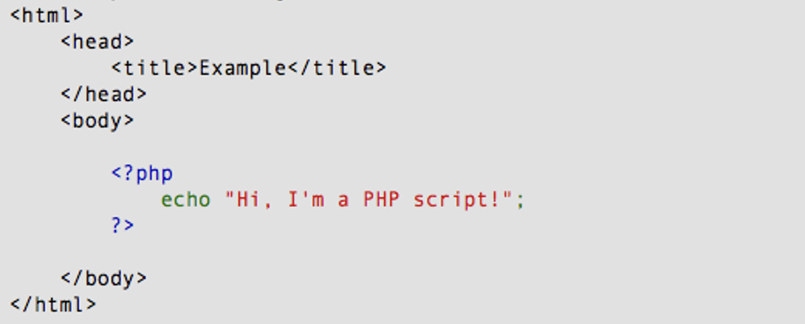
PHP Introduction

Slide 34
PHP Introduction
PHP code is executed on the server, generating HTML which is then
sent to the client. The client would receive the results of running that
script, but would not know what the underlying code was.

Slide 35
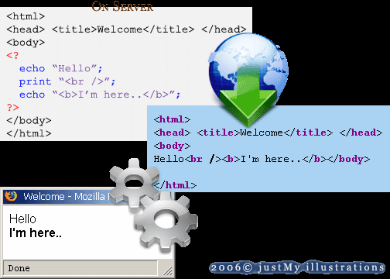
PHP Introduction

Slide 36
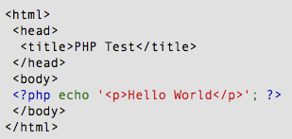
PHP Hello World

Slide 37
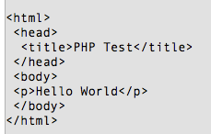
PHP Hello World
It renders as HTML that looks like this:

Slide 38
PHP Hello World
This program is extremely simple and you really did not need to use PHP to create a page like this. All it does is display: Hello World using the PHP echo() statement.
Think of this as a normal HTML file which happens to have a set of special tags available to you that do a lot of interesting things.

Slide 39
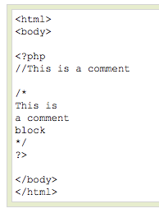
PHP Comments
In PHP, we use // to make a single-line comment or /* and */ to make a large comment block.

Slide 40
PHP Variables
Variables in a program are used to store some values or data that can be used later in a program.
The variables are also like containers that store character values, numeric values, memory addresses, and strings.
PHP has its own way of declaring and storing variables.
There are a few rules, that need to be followed and facts that need to be kept in mind while dealing with variables in PHP.

Slide 41
PHP Variables
A variable can have long descriptive names (like $factorial, $even_nos) or short names (like $n or $f or $x)
A variable name can only contain alphanumeric characters and underscores (i.e., ‘a-z’, ‘A-Z’, ‘0-9, and ‘_’) in their name. Even it cannot start with a number.
A constant is used as a variable for a simple value that cannot be changed. It is also case-sensitive.
Assignment of variables is done with the assignment operator, “equal to (=)”. The variable names are on the left of equal and the expression or values are to the right of the assignment operator ‘=’.

Slide 42
PHP Variables
One must keep in mind that variable names in PHP names must start with a letter or underscore and no numbers.
PHP is a loosely typed language, and we do not require to declare the data types of variables, rather PHP assumes it automatically by analysing the values.
The same happens while conversion. No variables are declared before they are used. It automatically converts types from one type to another whenever required.
PHP variables are case-sensitive, i.e., $sum and $SUM are treated differently.

Slide 43
Data types used by PHP to declare or construct variables:
Integers
Doubles
NULL
Strings
Booleans
Arrays
Objects
Resources

Slide 44
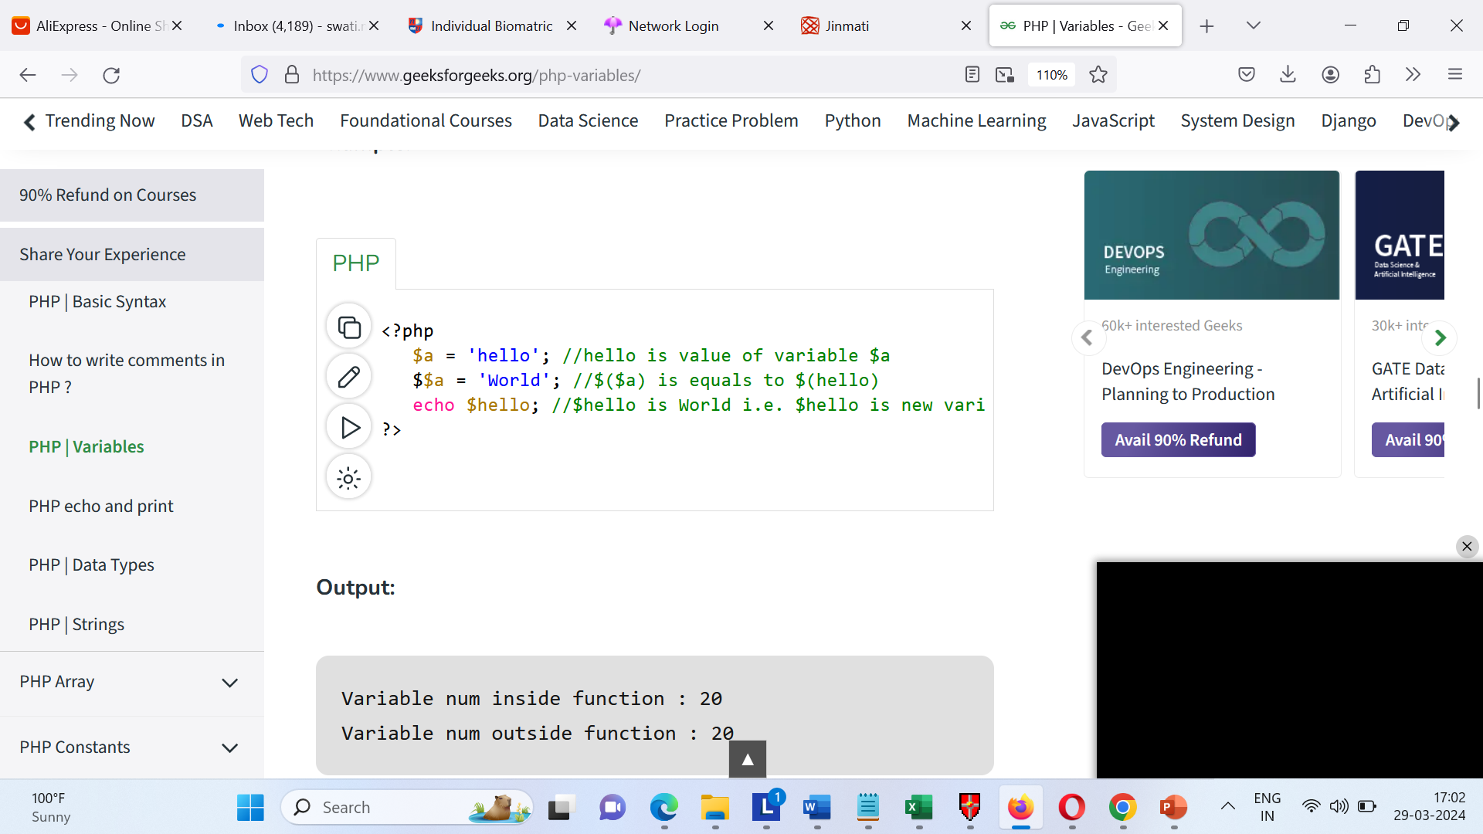
Example
<?php
$num = 20;
// function to demonstrate use of global variable
function global_var()
{
// we have to use global keyword before
// the variable $num to access within
// the function
global $num;
echo "Variable num inside function : $num \n";
}
global_var();
echo "Variable num outside function : $num \n";
?>

Slide 45
Variable Scopes
Scope of a variable is defined as its extent in a program within which it can be accessed, i.e. the scope of a variable is the portion of the program within which it is visible or can be accessed. Depending on the scopes, PHP has three variable scopes.
Local variables: The variables declared within a function are called local variables to that function and have their scope only in that particular function. In simple words, it cannot be accessed outside that function. Any declaration of a variable outside the function with the same name as that of the one within the function is a completely different variable. We will learn about functions in detail in later articles. For now, consider a function as a block of statements.

Slide 46
Variable Scopes
Global variables: The variables declared outside a function are called global variables. These variables can be accessed directly outside a function. To get access within a function we need to use the “global” keyword before the variable to refer to the global variable.

Slide 47
Static variable:
Static variable: It is the characteristic of PHP to delete the variable, once it completes its execution and the memory is freed. But sometimes we need to store the variables even after the completion of function execution. To do this we use the static keywords and the variables are then called static variables. PHP associates a data type depending on the value for the variable.

Slide 48
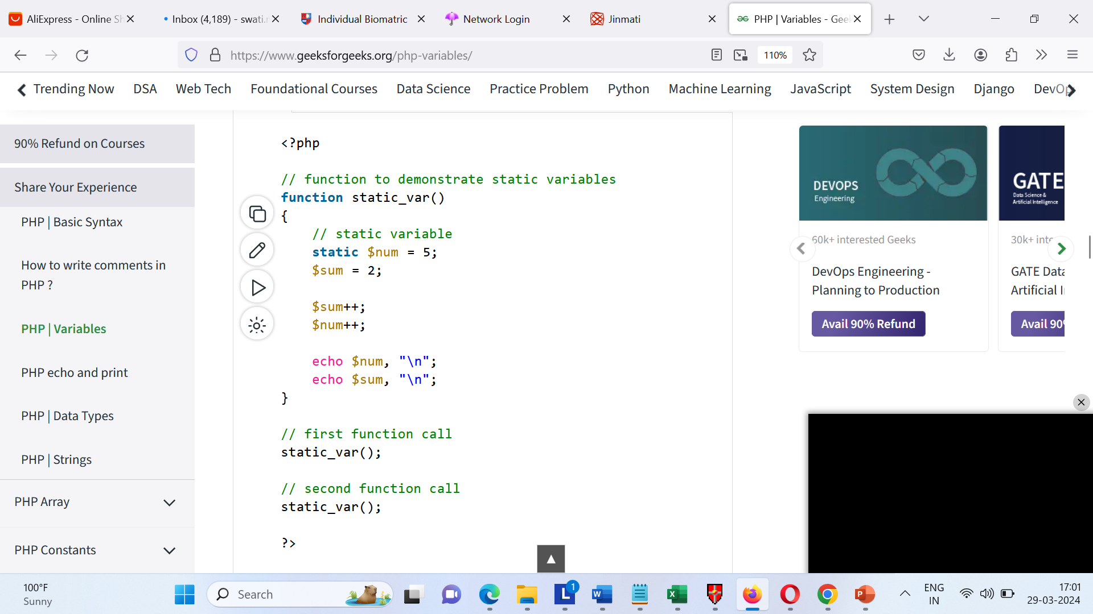
Variable Scopes

Slide 50
PHP Functions
PHP function is a piece of code that can be reused many times. It can take input as argument list and return value. There are thousands of built-in functions in PHP.
In PHP, we can define Conditional function, Function within Function and Recursive function also
Advantage of PHP Functions
Code Reusability: PHP functions are defined only once and can be invoked many times, like in other programming languages.
Less Code: It saves a lot of code because you don't need to write the logic many times. By the use of function, you can write the logic only once and reuse it.

Slide 51
PHP Functions
PHP User-defined Functions
We can declare and call user-defined functions easily. Let's see the syntax to declare user-defined functions.
Syntax
function functionname()
{
//code to be executed
}

Slide 52
PHP Functions
PHP Functions Example
File: function1.php
<?php
function sayHello(){
echo "Hello PHP Function";
}
sayHello();//calling function
?>
Output:
Hello PHP Function

Slide 53
PHP Function Arguments
We can pass the information in PHP function through arguments which is separated by comma.
PHP supports Call by Value (default), Call by Reference, Default argument values and Variable-length argument list.

Slide 54
PHP Function Arguments
File: functionarg.php
<?php
function sayHello($name){
echo "Hello $name<br/>";
}
sayHello("Sonoo");
sayHello("Vimal");
sayHello("John");
?>
Output:
Hello Sonoo Hello Vimal Hello John

Slide 55
PHP Function Arguments
Let's see the example to pass two argument in PHP function.
File: functionarg2.php
<?php
function sayHello($name,$age){
echo "Hello $name, you are $age years old<br/>";
}
sayHello("Sonoo",27);
sayHello("Vimal",29);
sayHello("John",23);
?>
Output:
Hello Sonoo, you are 27 years old
Hello Vimal, you are 29 years old
Hello John, you are 23 years old

Slide 56
PHP Call By Reference
Value passed to the function doesn't modify the actual value by default (call by value). But we can do so by passing value as a reference.
By default, value passed to the function is call by value. To pass value as a reference, you need to use ampersand (&) symbol before the argument name.

Slide 57
PHP Call By Reference
<?php
function adder(&$str2)
{
$str2 .= 'Call By Reference';
}
$str = 'Hello ';
adder($str);
echo $str;
?>
Output
Hello Call By Reference

Slide 58
PHP Function: Default Argument Value
We can specify a default argument value in function. While calling PHP function if you don't specify any argument, it will take the default argument. Let's see a simple example of using default argument value in PHP function.
File: functiondefaultarg.php
<?php
function sayHello($name="Sonoo"){
echo "Hello $name<br/>";
}
sayHello("Rajesh");
sayHello();//passing no value
sayHello("John");
?>
Output:
Hello Rajesh
Hello Sonoo
Hello John

Slide 59
PHP Function: Returning Value
Let's see an example of PHP function that returns value.
File: functiondefaultarg.php
<?php
function cube($n){
return $n*$n*$n;
}
echo "Cube of 3 is: ".cube(3);
?>
Output:
Cube of 3 is: 27

Slide 60
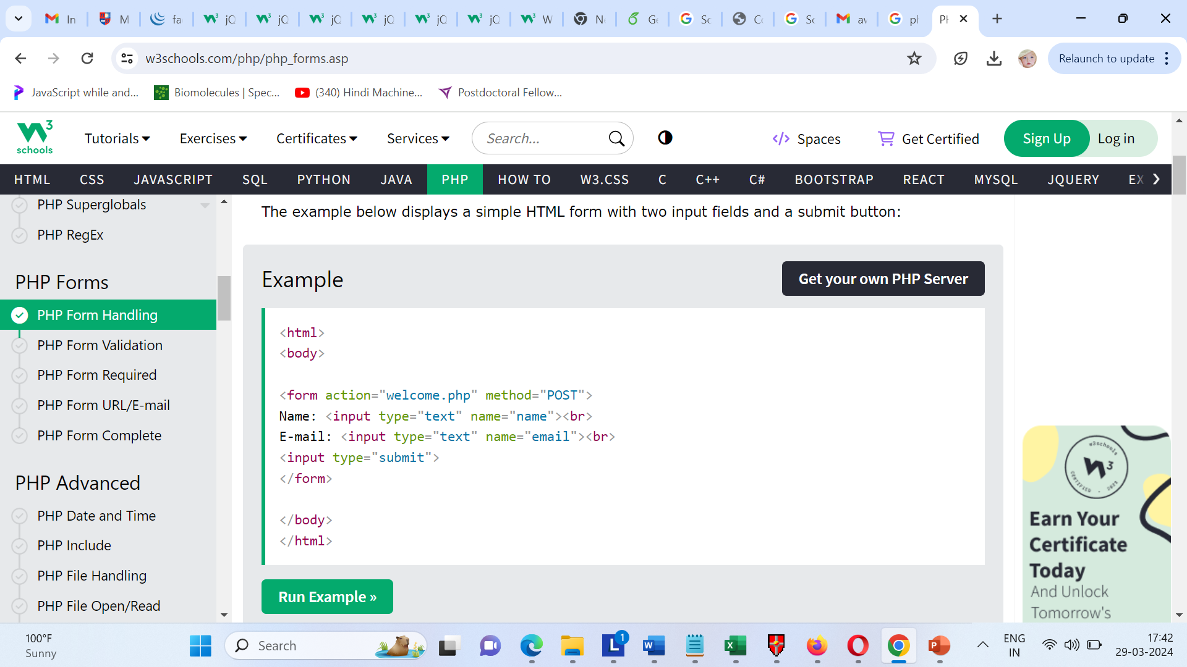
PHP Form Handling
The PHP superglobals $_GET and $_POST are used to collect form-data.
PHP - A Simple HTML Form
The example below displays a simple HTML form with two input fields and a submit button:
Example:

Slide 61
Introduction to PHP form processing
To create a form, you use the <form> element as follows:
<form action="form.php" method="post"> </form>
The <form> element has two important attributes:
action: specifies the URL that processes the form submission. In this example, the form.php will process the form.
method: specifies the HTTP method for submitting the form. The most commonly used form methods are POST and GET. In this example, the form method is post.

Slide 62
Introduction to PHP form processing
The form method is case-insensitive. It means that you can use either post or POST. If you don’t specify the method attribute, the form element will use the get method by default.
Typically, a form has one or more input elements including text, password, checkbox, radio button, select, file upload, etc. The input elements are often called form fields.
An input element has the following important attributes name, type, and value. The name attribute will be used for accessing the value in PHP.

Slide 63
HTTP POST method
If a form uses the POST method, the web browser will include the form data in the HTTP request’s body. After submitting the form, you can access the form data via the associative array $_POST in PHP.
For example, if a form has an input element with the name email, you can access the email value in PHP via the $_POST['email']. If the form doesn’t have an email input, the $_POST won’t have any element with the key 'email'.

Slide 64
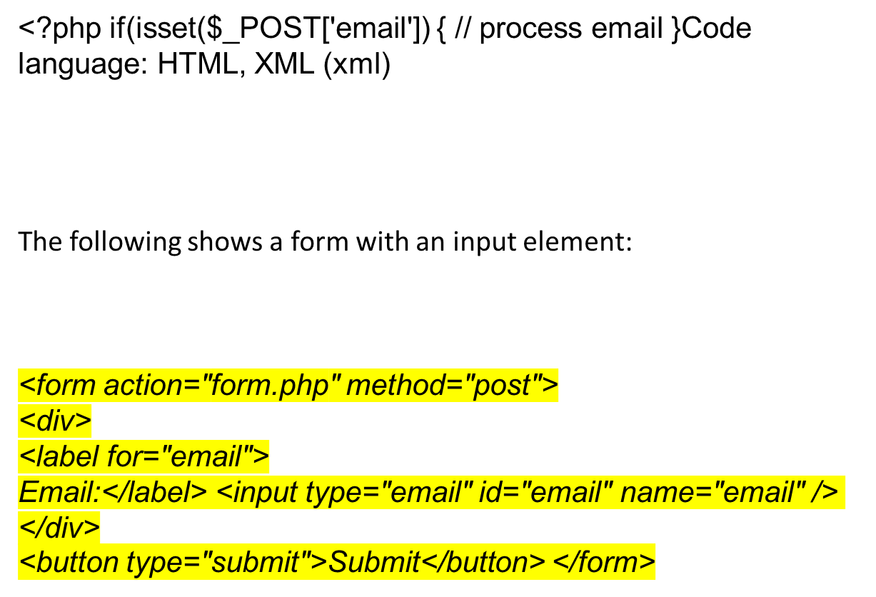
HTTP POST method

Slide 65
HTTP GET or POST
HTTP GET or POST
In general, you should use the GET method when the form only retrieves data from the server. For example, a search form that allows users to search for information should use the GET method.
When you have a form that causes a change in the server, you should use the POST method. For example, a form that allows users to subscribe to a newsletter should use the POST method.

Slide 66
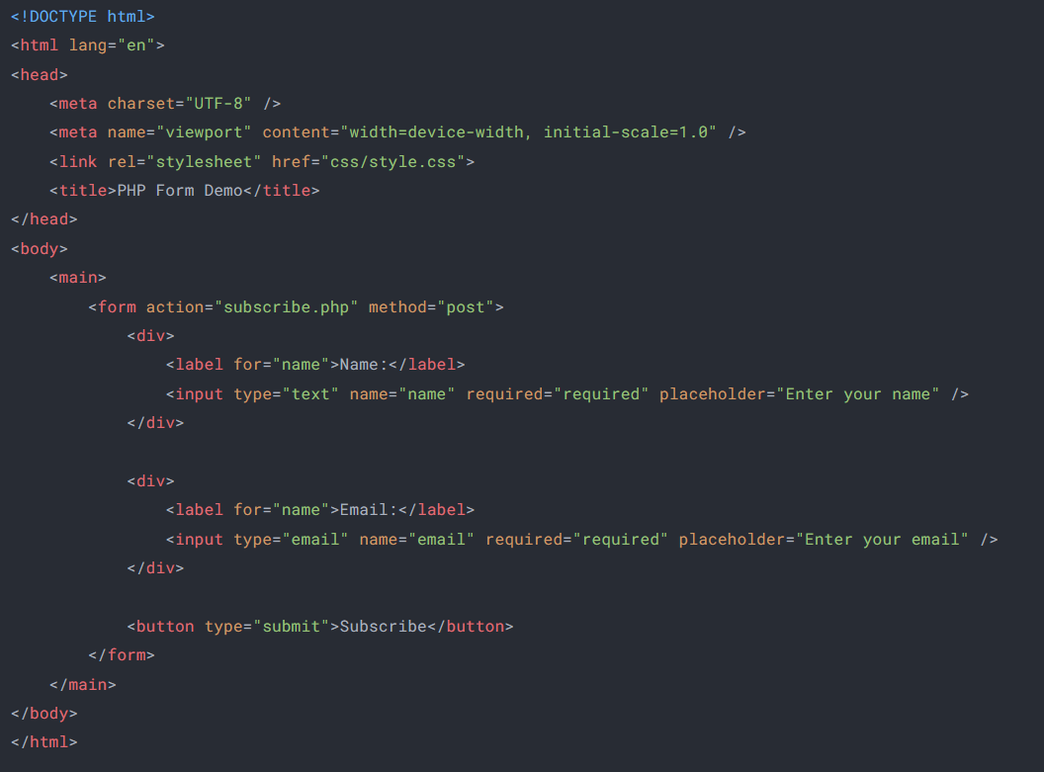
HTTP GET or POST

Slide 67
TEXT BOOK
1. Steven Holzner, “The Complete Reference PHP”, Tata McGraw Hill Pvt.Ltd., 2008.
BOOK FOR REFERENCE
1. Leon Atkinson, “Core PHP Programming”, Pearson Education, 2004.

Slide 68
THANK YOU

